Slide 1
Identify Signs of Diabetic Retinopathy
Using Convolution Neural Networks
Developed by: Bonthula Bhanu Sahith, Venkat Anand Sai Duggirala, Manchikanti Vikas, Jayanta Mukherjee, Nerella Anirudh
Smart Bridge-Remote Summer Internship Program

Slide 2
Contents
Introduction
Problem description
Solution
CNN
Dataset
Practical implementation
Results
Conclusion
Acknowledgments

Slide 3
Introduction
In this project we are going to deal with the classification of the different stages of the diabetic retinopahty. To detect this we are going to use classiﬁcation algorithms of DL. Even though there are classiﬁcation algorithms in ML like KNN, SVM, Random Forests, Decision Trees and Logistic Regression, we use DL algorithm of CNN i.e., Convolution Neural Network. This is because the data that we are going give as input is an image of any format png and this is actually a Gaussian Filtered image.

Slide 4
1.1 Overview
In this project as stated above we are going to deal with the classiﬁcation on gaussian images using CNN and predict whether the person is having diabetic retina problem to a certain degree or not.We chose CNN algorithm because it's a neural network which is capable of object recognition and deals with computer vision. CNN's can derive minor details from an image known as features and basing in that can classify other images into separate categories. This is a supervised learning as the images are already labeled in dataset

Slide 5
1.2 Purpose
The aim of the project is to make use of the packages like numpy, cv2, skimage, keras, tensorﬂow to use CNN and build a model that would classify the given image in either of the ﬁve categories i.e., no_DR, DR, mild, moderate, severe.
In this project we also made use of the web application and ﬁnally we have created an application a person can check whether he /she is having a diabetic retinal damage or not just by inputting the image scanned of his eye.

Slide 6
Problem Description
D iabetic Retinopathy is the leading cause of blindness in the working-age population of the developed world. It is estimated to affect over 93 million people.The US Center for Disease Control and Prevention estimates that 29.1 million people in the US have diabetes and the World Health Organization estimates that 347 million people have the disease worldwide. D iabetic Retinopathy DR is an eye disease associated with long-standing diabetes.

Slide 7
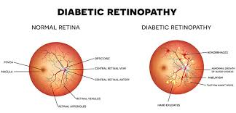

Slide 8
Around 4 0% to 45% of Americans with diabetes have some stage of the disease. shows few symptoms until it is too late to provide effective treatment.
Progression to vision impairment can be slowed or averted if DR is detected in time, however this can be difficult as the disease often shows few symptoms until it is too late to provide effective treatment.
Currently, detecting DR is a time-consuming and manual process that requires a trained clinician to examine and evaluate digital color fundus photographs of the retina. By the time h uman readers submit their reviews, often a day or two later, the delayed results lead to lost follow up, miscommunication, and delayed treatment.

Slide 9
Solution
This project is capable of classifying images based on disease pathology from four severity levels. A convolutional neural network (CNN) convolves an input image with a defined weight matrix to extract specific image features without losing spatial arrangement information. There will be a web application through which user can give their input image then they can check the predicted output and this application is integrated with trained CNN model.

Slide 10
CNN
T here are three basic components to deﬁne a basic convolutional network.
1. The convolutional layer
2. The Pooling layer[optional]
3. The output layer

Slide 11
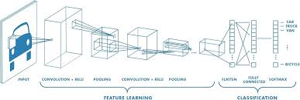
The convolutional layer:
Image of size 6*6. We deﬁne a weight matrix which extracts certain features from the i mages. Weight as a 3*3 matrix. This weight shall now run across the image such that all t he pixels are covered at least once, to give a convolved output.

Slide 12
The weight matrix behaves like a ﬁlter in an image extracting particular information from the original image matrix. A weight combination might be extracting edges.
If stride is equal to 1,then weight matrix moves 1 step a head.It acts as a hyper-parameter.If stide is more then there will be a loss of information(Pixels present in the corner of the image are used only a few number of times during convolution as compared to the central pixels. Hence, we do not focus too much on the corners since that can lead to information loss ).
To overcome this issue,Padding is is used over there. initial shape of the image is retained after we pad the image with a zero. This is known as same padding.

Slide 13
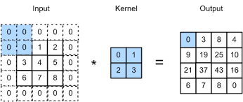
In most cases instead of a single ﬁlter(weight matrix), we have multiple ﬁlters of the s ame dimensions applied together.

Slide 14
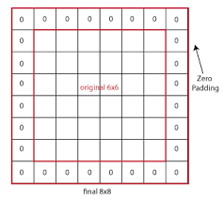

Slide 15
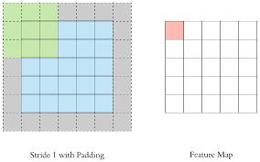

Slide 16
Dataset
The dataset for this project has been taken from the Gaussian-ﬁltered images for diabetic retinopathy in kaggle dataset repository. This dataste has all images already smoothened by applying gaussian ﬁlter. This dataset has two different folders i.e., train and test folders which inturn have ﬁve folders each namely mild, moderate, proliferate_DR, no_DR and severe. The ratio of train and test folders is 80:20. The train folder has 2929 images and test dataset has 733.

Slide 17
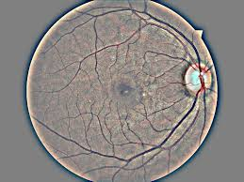

Slide 18
Practical Implementation
We used the following in the project:
Jupyter notebook
Spyder ide
HTML
Flask in python
Tensorflow
Keras
DL Algorithms
Numpy in python
openCV

Slide 19
Data preprocessing:
We use Keras’ ImageDataGenerator class to perform data augmentation. i.e, we are using some kind of parameters to process our collected data. The word “augment” means to make something “greater” or “increase” something (in this case, data), the Keras ImageDataGenerator class actually works by:
Accepting a batch of images used for training. Taking this batch and applying a series of random transformations to each image in the batch (including random rotation, resizing, shearing, etc.). Replacing the original batch with the new, randomly transformed batch. Training the CNN on this randomly transformed batch (i.e., the original data itself is not used for training).
Note: The ImageDataGenerator accepts the original data, randomly transforms it, and returns only the new, transformed data

Slide 20
We import the libraries and apply imgdatagenerator.
Note: The ImageDataGenerator accepts the original data, randomly transforms it, and returns only the new, transformed data

Slide 21
Building the model:
Step1: Defining Model architecture:
Defining Model architecture: For image classification we use Convolution neural network .
This is a very crucial step in our deep learning model building process. We have to define how our model will look and that requires
Importing the libraries, Initializing the model, Adding CNN (Convolution Neural Network) Layers, Adding Dense layers .

Slide 22
This is a very crucial step in our deep learning model building process. We have to define how our model will look and that requires
Importing the libraries Initializing the model Adding CNN (Convolution Neural Network) Layers Adding Dense layers
Adding a CNN Layers:
We will be adding three layers for CNN
Convolution layer
Pooling layer
Flattening layer and then adding dense layers.

Slide 23
Step 2: Configuring the learning process:
With both the training data defined and model defined, it's time configure the learning process. This is accomplished with a call to the compile() method of the Sequential model class. Compilation requires 3 arguments: an optimizer, a loss function, and a list of metrics.
In our example, set up as a multi-class classification problem, we will use the Adam optimizer, the categorical cross entropy loss function, and include solely the accuracy metric.

Slide 24
Step 3: Train the model
At this point we have training data and a fully configured neural network to train with said data. All that is left is to pass the data to the model for the training process to commence, a process which is completed by iterating on the training data. Training begins by calling the fit() method.
Note: This steps takes few minutes based on the epochs (no : of time you would like to train the machine with the given data set ) you give .
It took around 100 epochs in project.

Slide 25
Step 4: Save The Model:
Your model is to be saved for the future purpose. This saved model ac also be integrated with android application or web application in order to predict something
Step 5: Prediction:
The last and final step is to make use of Saved model to do predictions. We use load model class to load the model. We use imread() class from opencv library to read an image and give it to the model to predict the result. Before giving the original image to predict the class, we have to pre-process that image and apply predictions to get accurate results.

Slide 26
Results
In this project, we use a Convolution Neural Network with a simple 2 layer design and cataragorical cross-entropy to adjust the weights every training cycle. Each epoch as 92 training cycles/steps. The hidden layer uses Relu activation function while the output layer uses softmax activation function. The model has been trained for exactly 100 epochs. We use categorical accuracy as a metric to determine the accuracy of the model. The ﬁnal trained model has and estimated prediction accuracy of 89% which is very high. I t is understood that this accuracy may be improved upon by training the model for more epochs and feeding it a larger dataset.

Slide 27
Conclusion
In this project, the CNN algorithm is adopted to build a UI model for predicting the severity of Diabetic retinopathy, by predicting based on the images of retinal scans. The convolution neural network has a simple 2-layer design and uses categorical cross entropy for tweaking its weights every epoch. The model has been trained for a total of 100 epochs over a large dataset. The model achieves a prediction accuracy of 89% which is very high and delivers the results immediately. Therefore, it can be concluded that training a large dataset over 100 epochs in CNN can yield highly accurate models.

Slide 28
Acknowledgments
●https://keras.io/api/losses/probabilistic_losses/#categorical_crossentropy-function
● https://keras.io/api/layers/activations
●https://www.kaggle.com/c/diabetic-retinopathy-detection
●http://papers.nips.cc/paper/4824-imagenet-classiﬁcation-with-deep-convolutional neural-networks.pdf
●https://www.tensorﬂow.org/api_docs/python/tf/keras/layers/Dense

Slide 29
THANK YOU

